Slide 1
AI FAQ
Assistant

Slide 2

Riverside Gardens · Town hall 2026
Agenda
01
Why support teams need an AI FAQ workflow
02
System architecture and request flow
03
Security, data model, and API operations
04
Setup, testing, and developer handoff
02

Slide 3
Riverside Gardens · Town hall 2026
Support teams need answers that stay organized
Repetition is the signal. Structure is the response.
What the team faces
What the backend creates
Repetitive inquiries
Manual drafting
Scattered documentation
Limited visibility into search trends
A centralized backend that turns questions into structured, searchable FAQ content.
03

Slide 4

Riverside Gardens · Town hall 2026
One API coordinates the full FAQ lifecycle
Each request moves through a controlled backend path.
Client Requests
Express Routing
Middleware Validation
Persistence & AI
04

Slide 5

Riverside Gardens · Town hall 2026
Security is enforced before data changes
Identity, credentials, authorization, and errors are handled before persistence.
Bcrypt Hashing
Authorization Rules
JWT Sessions
Error Handling
Protect routes and set user context
Sanitize responses; avoid leaking DB details
Hash passwords before storing
Creators manage own records; admins control all
05

Slide 6

Riverside Gardens · Town hall 2026
The data model keeps people, FAQs, and categories connected
Relationships make content manageable, searchable, and reviewable.
User
FAQ
Creates and manages multiple FAQ records for review.
Central collection linked to categories and search matching.
Category
AI-Generated
Organizes published FAQ content for navigation and search.
Drafted answers reviewed and saved into the FAQ collection.
06

Slide 7




Riverside Gardens · Town hall 2026
Four roles keep access predictable
Admin
Content creator
Manages users, FAQs, categories, and AI-generated content.
Creates, edits, deletes, categorizes, and generates FAQs.
Authenticated user
Public user
Searches public FAQs and requests AI-assisted answers.
Reads and searches published FAQs without protected-route access.
07

Slide 8
Riverside Gardens · Town hall 2026
AI adds speed without bypassing the backend
Generate from a topic
Controllers stay in the path
Private clients can request a generated FAQ pair from a topic.
The result moves through validation and persistence rather than writing directly to the database.
Gemini supplies structure
Search gets faster
Google Gemini integration produces a question, answer, and category suggestion.
Semantic search helps users find the right answer faster.
08

Slide 9
Riverside Gardens · Town hall 2026
Setup stays lightweight for a cross-platform team
RUNTIME
CORE STACK
DEVELOPMENT LOOP
Node.js
Express · MongoDB · Mongoose
Initialize → install → start → verify
v18 or above
npm v9 or above
dotenv · CORS · JWT · bcrypt · Google GenAI
Verify routes in Postman or ThunderClient.
09

Slide 10

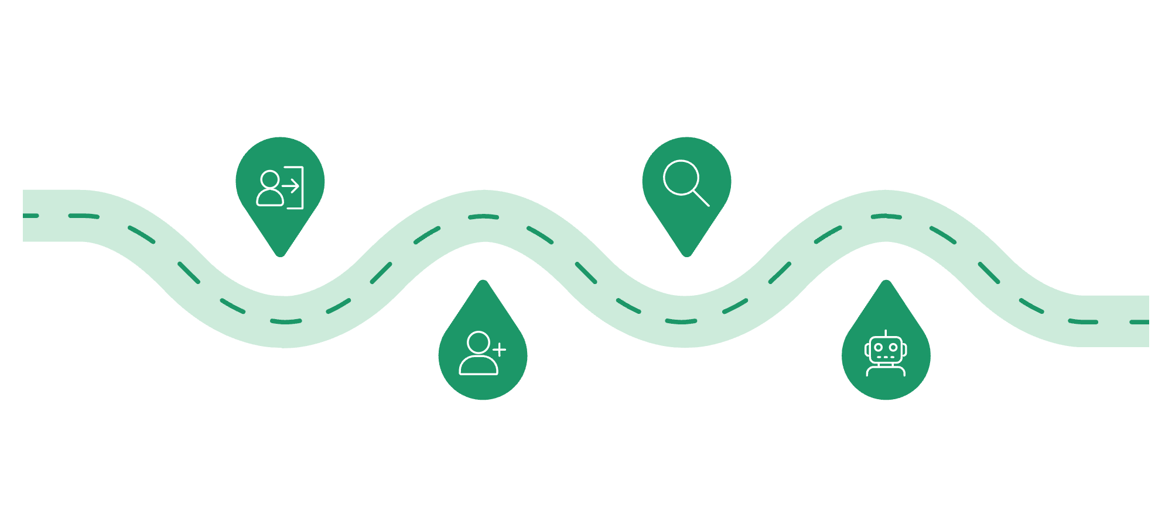
Riverside Gardens · Town hall 2026
Test the contract through five representative routes
Auth
Search
Register and log in via public routes
Query published FAQs via public route
Create FAQ
AI Generate
POST to protected bearer-token endpoint
Protected automation route creates FAQ pair
10

Slide 11
Riverside Gardens · Town hall 2026
Thank you
11

